Slide 1
MrBeast making a video making clean available to thousands in Africa is perfectly fine
My Hot Take

Slide 2
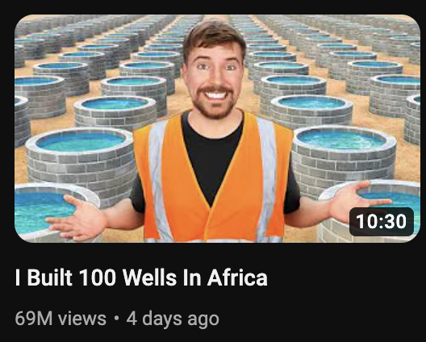
Backstory
Mr Beast, a youtuber with over 208 million subscribers, recently published a video in which he filmed himself donating/building 100 wells over Africa.
MrBeast became popular through stunts like giving away money, cars and other items
He has previously used his influence on protects like TeamTrees, a project that raised 24 million dollars, resulting in 24 million trees being planted
This video generated 69 million views in 4 days

Slide 3
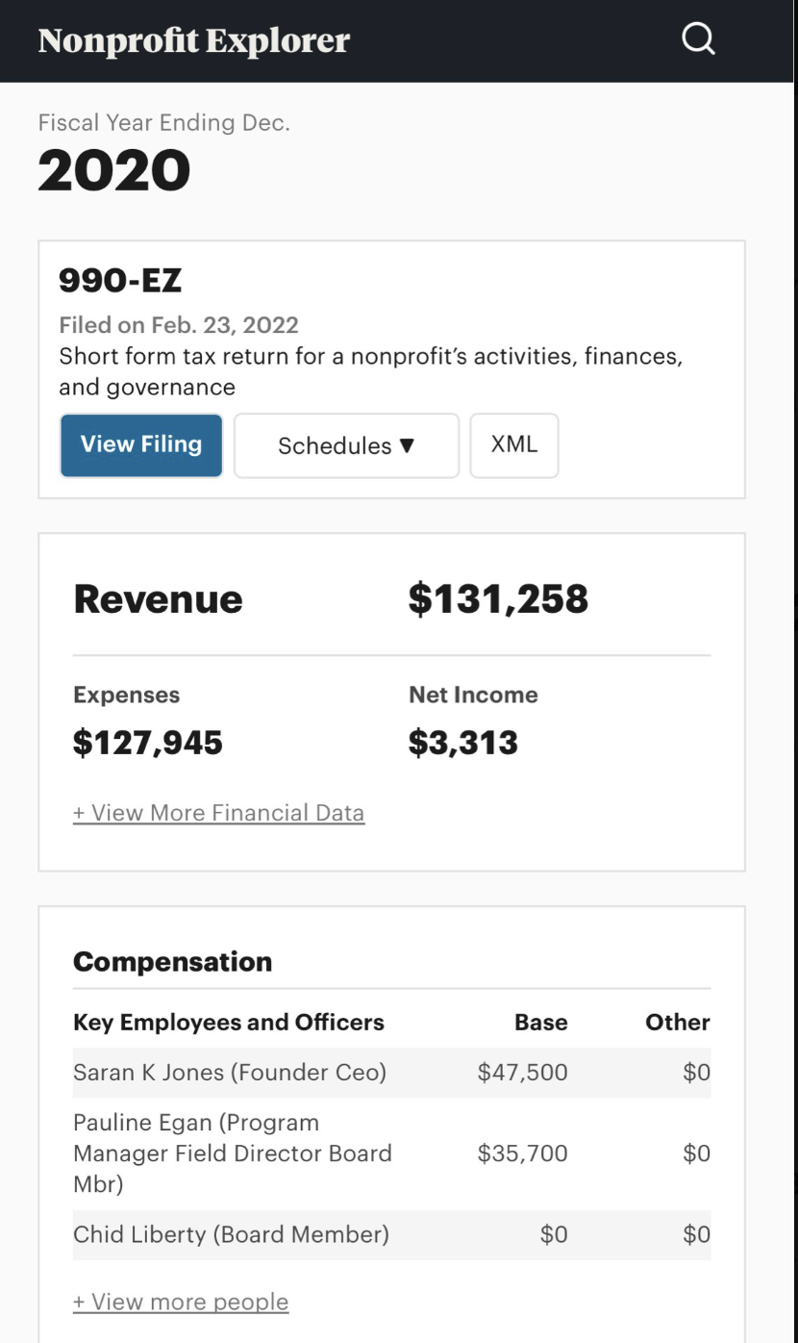
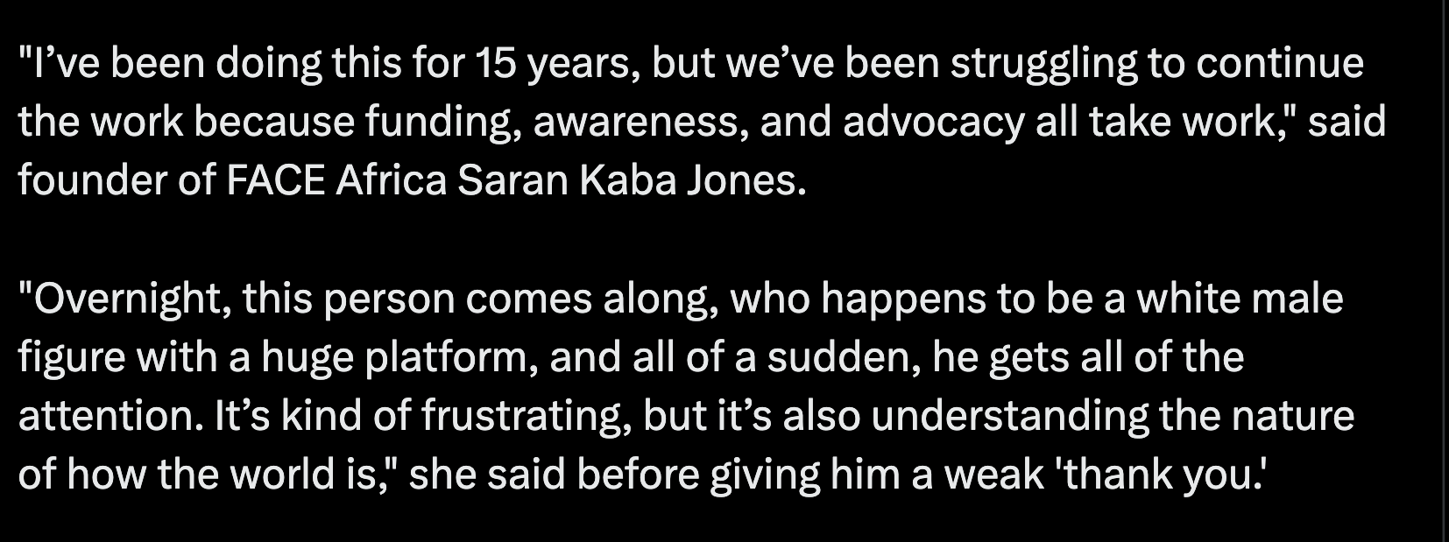
Quote from yahoo article
Raised 131k, and proceeded to spend £83k on themselves

Slide 4
Why build wells
Clean water is necessary for drinking, sanitation, hygiene, agriculture, and industry.
Around 2 billion people in the world lack access to safe water at home, and 4.5 billion lack adequate sanitation.
Diarrheal diseases are among the most common causes of death for children under 5, and can be easily prevented with clean water, sanitation, and hygiene.
Access to clean water can reduce the burden of fetching water, especially for women and girls, and allow them to pursue education and economic opportunities.
Investing in water and sanitation can yield high returns, with every $1 spent generating an average of $4 in increased productivity

Slide 5
The controversy
MrBeast is exploiting the poverty and suffering of Africans for his own profit and fame
MrBeast is using the money he raises from making the video to allow for projects like this to happen, the money has to come from somewhere
Additionally he made the video to inspire his audience to help and donate to causes such as this, creating a positive impact on viewers and the communities he aims to help^{sauce}
MrBeast is perpetuating the stereotype of Africa as a helpless and dependent continent that needs external intervention
MrBeast is not perpetuating the stereotype of Africa as a helpless and dependent continent, but rather highlighting the reality and urgency of the water crisis that affects millions of people in Africa and beyond
MrBeast is undermining the efforts and responsibilities of the African governments and civil society to address their own challenges
If they haven’t fixed the problem in the last 50 years, then surely they need help

Slide 6
What I think
MrBeast is using his platform and resources to raise awareness and funds for a global issue that affects millions of people.
MrBeast is partnering with local organizations and communities to ensure the sustainability and appropriateness of the wells, a legitimate concern that was raised by some

